Slide 1
ALLIGATOR
Guide Name: Mr. Santosh Katti
Assistant Professor, Dept of CA
PES University
Vijaykumar R Pai - PES1201702013
Ayush Pratyay – PES1201702164
Chinmay Prajapat – PES1201801858

Slide 2
abstract
the objective of the project is to monitor hostile activities in the militarized zone.
So soon as the camera detects some activity within the range, it starts recording the surrounding area. If it detects some suspicious activity, the camera will start focusing on the area under suspicion.
The camera can also do facial recognition, match with the data stored in the database and check whether the person is hostile or not.
It will immediately send the information to the authority to take necessary actions.
All the collected visuals will be stored on the cloud for future use.

Slide 3
introduction
The project is designed to alert the authorities of hostile activities going around their premises. If the device detects any motion around designed radius it warns the respective authorities by sending the email.
Pi camera is used to detect the motion and record the activities.
HC-sr04 which is an ultrasonic sensor will help in activating the camera once the intrusion is detected within a certain distance.
Motion detection software helps in detecting motion around the camera.
Using the Wi-Fi module we can upload the details in the cloud and alert the authorities through notification.

Slide 4
Literature survey
there are many solutions to this problem and each of them have their own way of tackling the problem. They use thermal sensors to detect heat signatures and cameras sensitive to thermal readings.
These have certain drawbacks as they won’t be able to give accurate readings if the environment conditions are poor.
These problems can be tackled by implementing motion detection and ultrasonic which will give accurate readings.
Along with these sensors the authorities will be notified of any threat in the premises

Slide 5
Technologies used
Software Requirements
Raspbian OS
Front end: Python 3, WordPress
Wia
Hardware Requirements
Raspberry Pi Model 3B
Raspberry Pi Camera Module
Ultrasonic Sensor
PIR Sensor
Breadboard
Jumper Wires
A housing for the camera

Slide 6
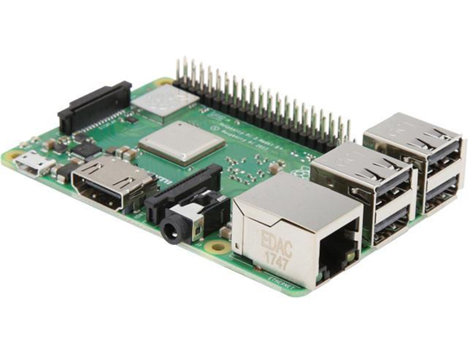
Raspberry Pi 3
The Raspberry Pi 3 Model B+ is the earliest of the third-generation raspberry pi.
It is powered by a 1.2 GHz Broadcom BCM2837 processor with BCM43438 wireless LAN.
It also has Bluetooth capabilities

Slide 7
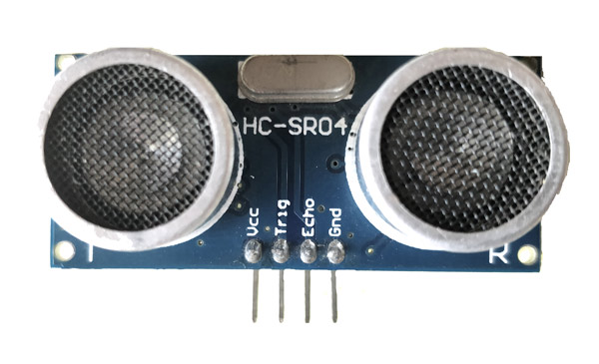
Ultrasonic sensor
the hc-sr04 ultrasonic sensor uses sonar to determine distance to an object.
It offers excellent non-contact range detection with high accuracy and stable readings in an easy-to-use package.

Slide 8

Wia
It is an Internet Of Things cloud platform to enable developers to turn various sensor-based hardware into fully fledged IoT devices.
This allows your simple devices to communicate with each other.

Slide 9
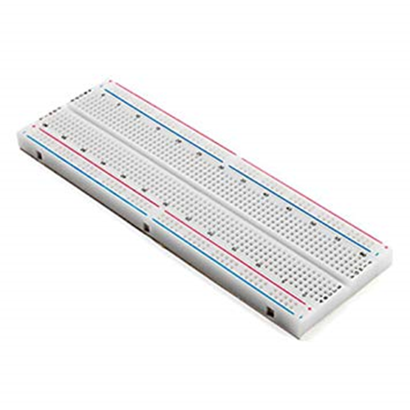
Breadboard
A breadboard is a solderless device for temporary prototype with electronics and test circuit designs.

Slide 10
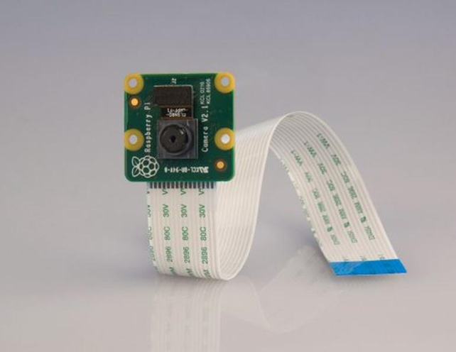
Camera module
The Raspberry Pi Camera Module v2 is a high quality 5 megapixel Sony IMX219 image sensor custom designed add-on board for Raspberry Pi.
It has the capability to record videos and take pictures at a resolution of 5 megapixels.

Slide 11
Functional Requirements
Detects if there is a motion in the environment.
Activates the camera and starts recording the surroundings.
Alerts the authorities.
Stores the recorded visuals on cloud for future use.

Slide 12
Non- Functional Requirements
Availability
Maintainability
Performance
Simplicity

Slide 13
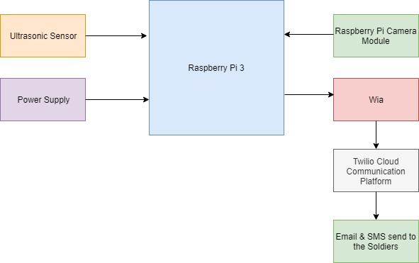
Block diagram

Slide 14
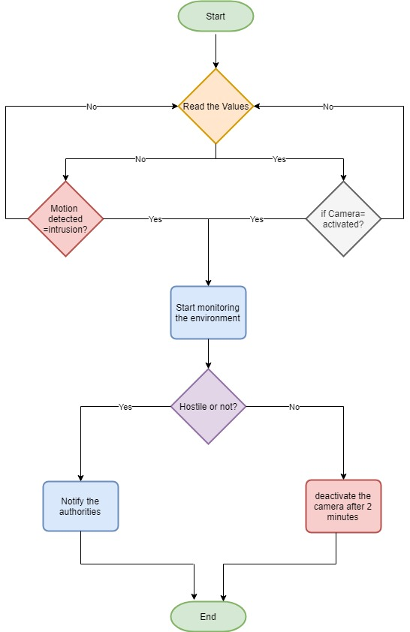
Flow diagram

Slide 15
Thank You

